Slide 1
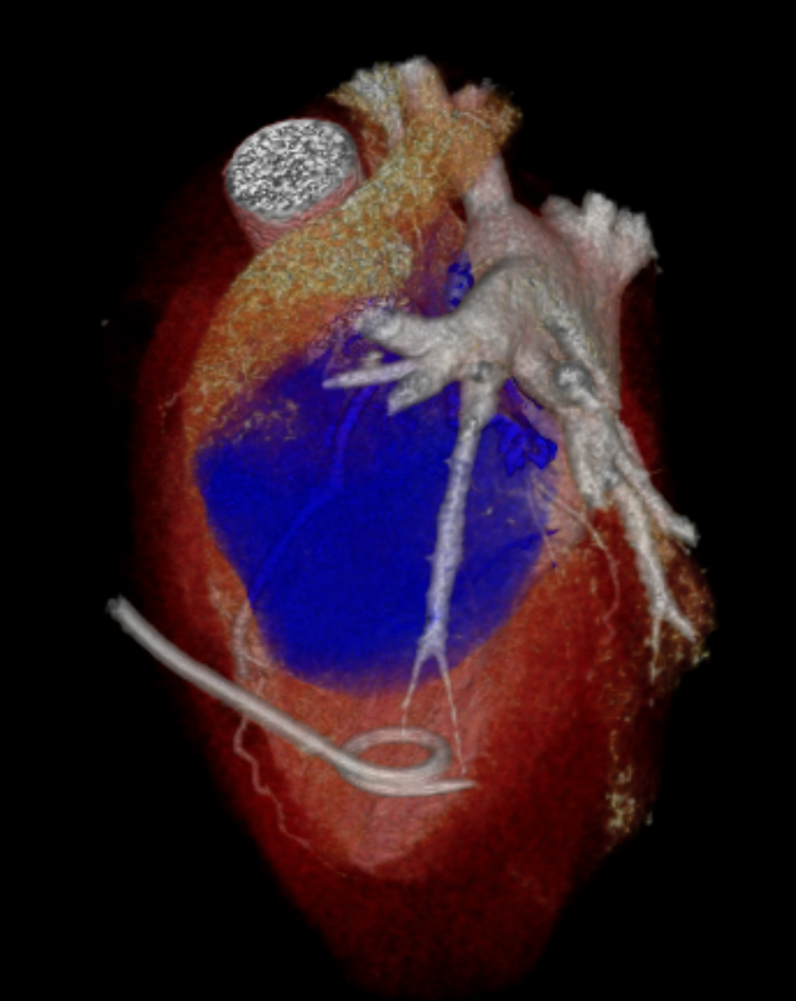
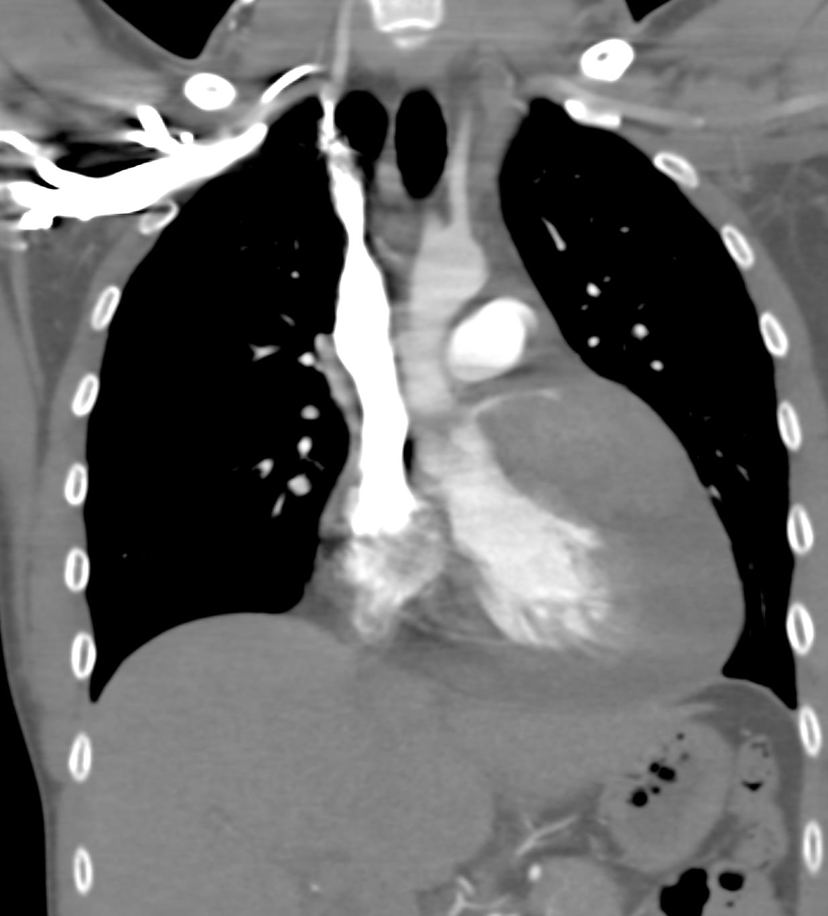
Case of the Day
Prepared by Dr. Subin Kuruvilla Thomas MBBS and Dr. Elsie T. Nguyen MD, FRCPC, FNASCI
Joint Department of Medical Imaging, University of Toronto

Slide 2
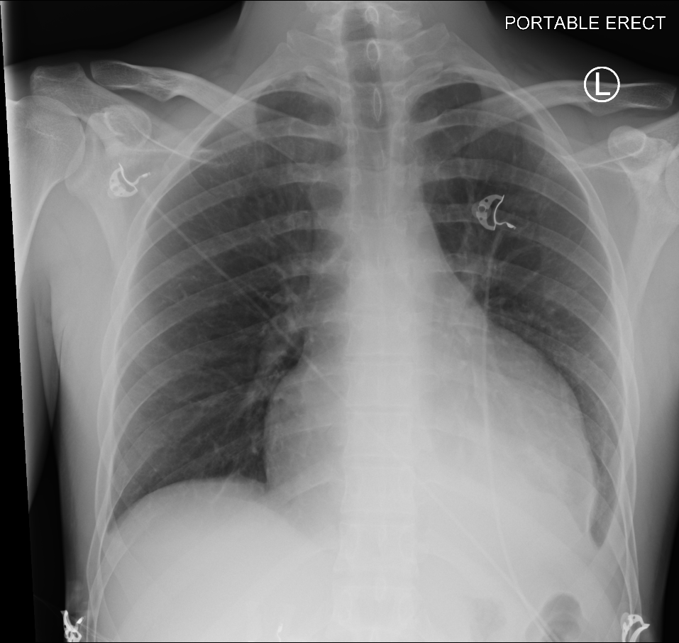
History: 20 year old man with shortness of breath.
CXR
CT
MRI
*
CXR shows enlarged cardio-pericardial contour and left lower lobe atelectasis. CT and MRI demonstrate a lobulated, enhancing mass encasing the left main and LAD (arrow), invading the anterior septum and anterior wall of the left ventricle and moderate pericardial effusion. The RVOT (*) is narrowed by the mass.

Slide 3
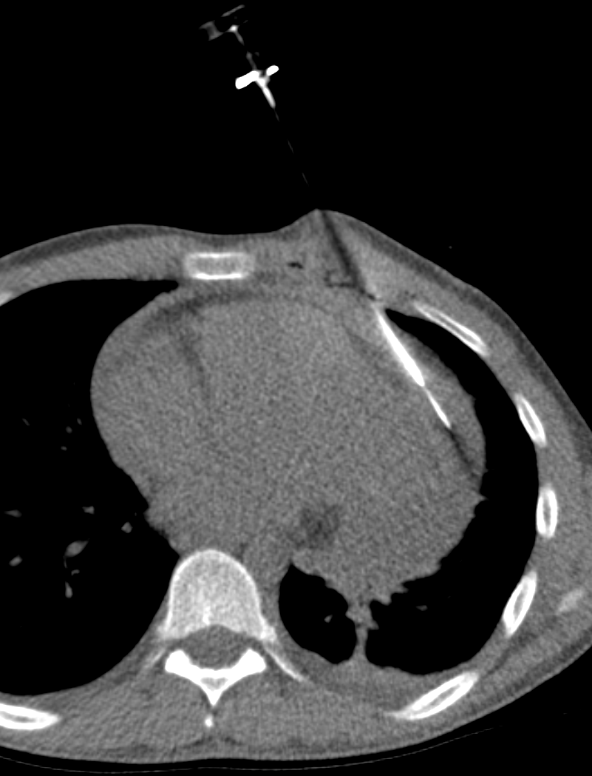
Diagnosis was obtained by percutaneous CT guided biopsy
A pericardial drain was inserted post biopsy to prevent tamponade

Slide 4
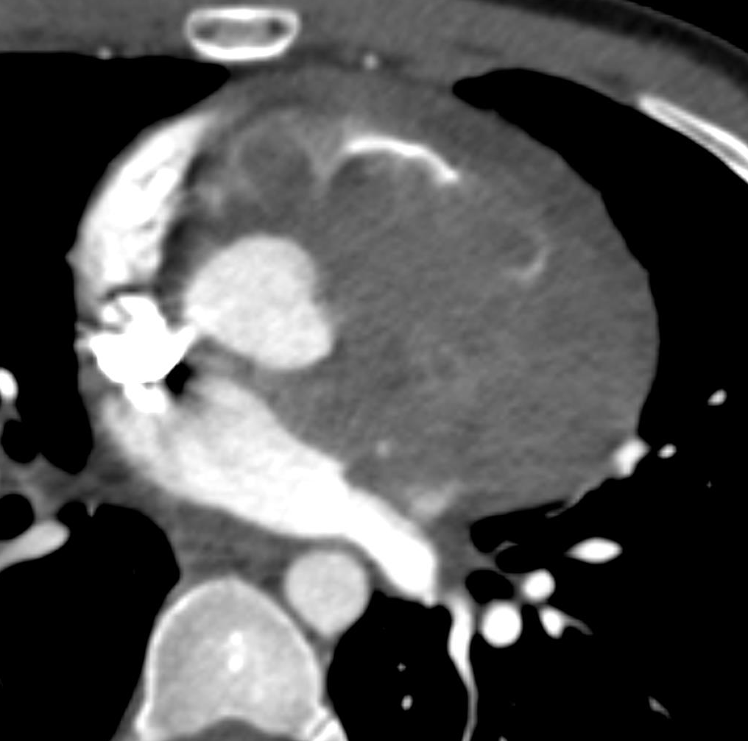
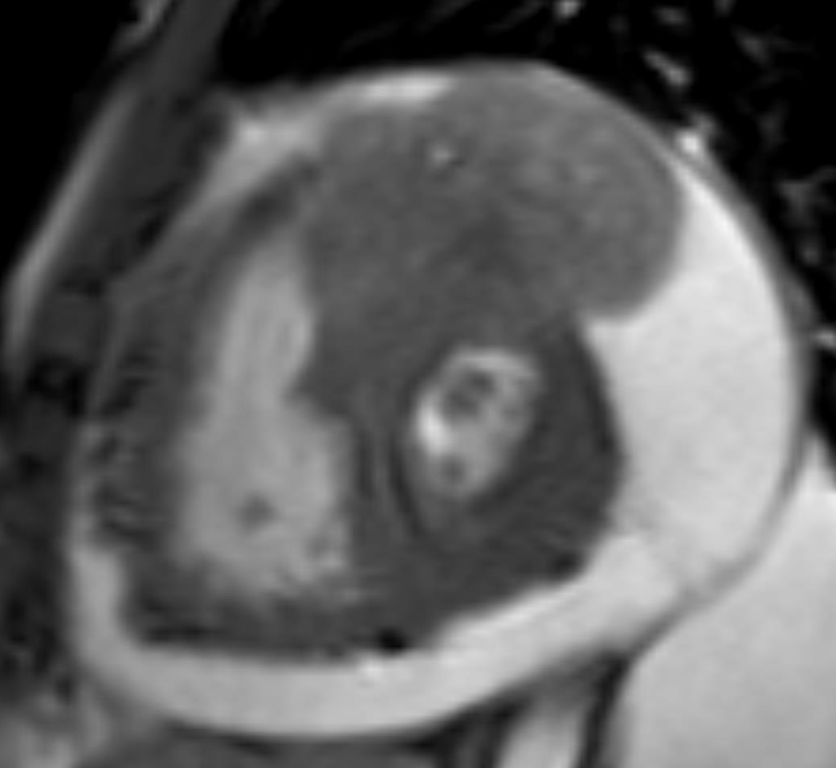
Diagnosis: Cardiac Synovial Sarcoma
*
Teaching points: Synovial sarcoma involving the heart is very rare with poor prognosis. Cardiac synovial sarcoma comprise less than 5% of all primary sarcomas involving the pericardium or cardiac chambers.
Synovial sarcomas are often biphasic tumors composed of spindle cells and epithelial cells and are characterized by the X;18 (p11:q11) chromosomal translocation.
Usually, they are found around the knee, often arising adjacent to joints or tendon sheaths.
Strong male predilection (3-20:1, M:F) usually in 30-39 year olds.
Primary Cardiac Synovial Sarcoma Ji-Gang Wang, MS, and Ning-Ning Li, MD Ann Thorac Surg 2013;95:2202–9

Slide 5
Treatment: Cardiac Synovial Sarcoma
Teaching points:
Treatment is surgical resection and chemotherapy with doxorubicin and ifosfamide
Mean survival is 59.9% at 1 year and 29.9% at 5 years.
*
Primary Cardiac Synovial Sarcoma Ji-Gang Wang, MS, and Ning-Ning Li, MD Ann Thorac Surg 2013;95:2202–9

